Slide 1

APPLICATION OF PARETO’S LAW TO SYSTEM PROCESSES AND NETWORK TRAFFIC TO DETECT ANOMALOUS BEHAVIOUR
Group-8
Supervisor : Prof. Mihai Lazarescu​
Supervisor : Prof. Mihai Lazarescu

Slide 2





Our Team
Ming Yong Tan
Abdul Aziz
Anuj Khatri
Samrat Bajgain
Diwash Limbu
21920794
21952506
21938690
21694785
21897377

Slide 3
Agenda
The 80/20 Principle: What is Pareto's Law?
Background & Motivation: Why is this needed?
Methodology: How did we test it?
Results & Evaluation: What did we find?
Conclusion: Why does it matter?

Slide 4

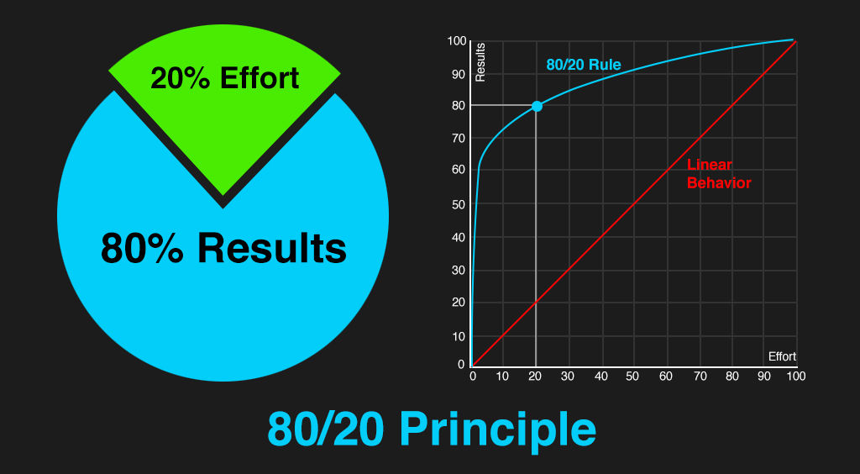

Introduction
The Pareto principle is a phenomenon that states that roughly 80% of outcomes come from 20% of causes.
Figure : Pareto's Principle

Slide 5
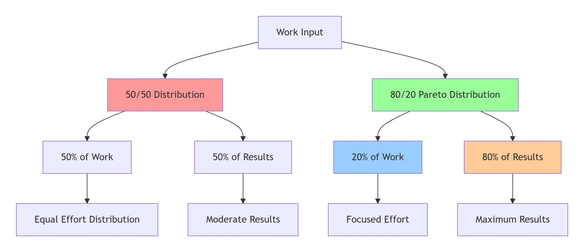
Why Pareto's Law ?
Maximize Efficiency - Improve Decision Making - Strategic Resource Allocation

Slide 6
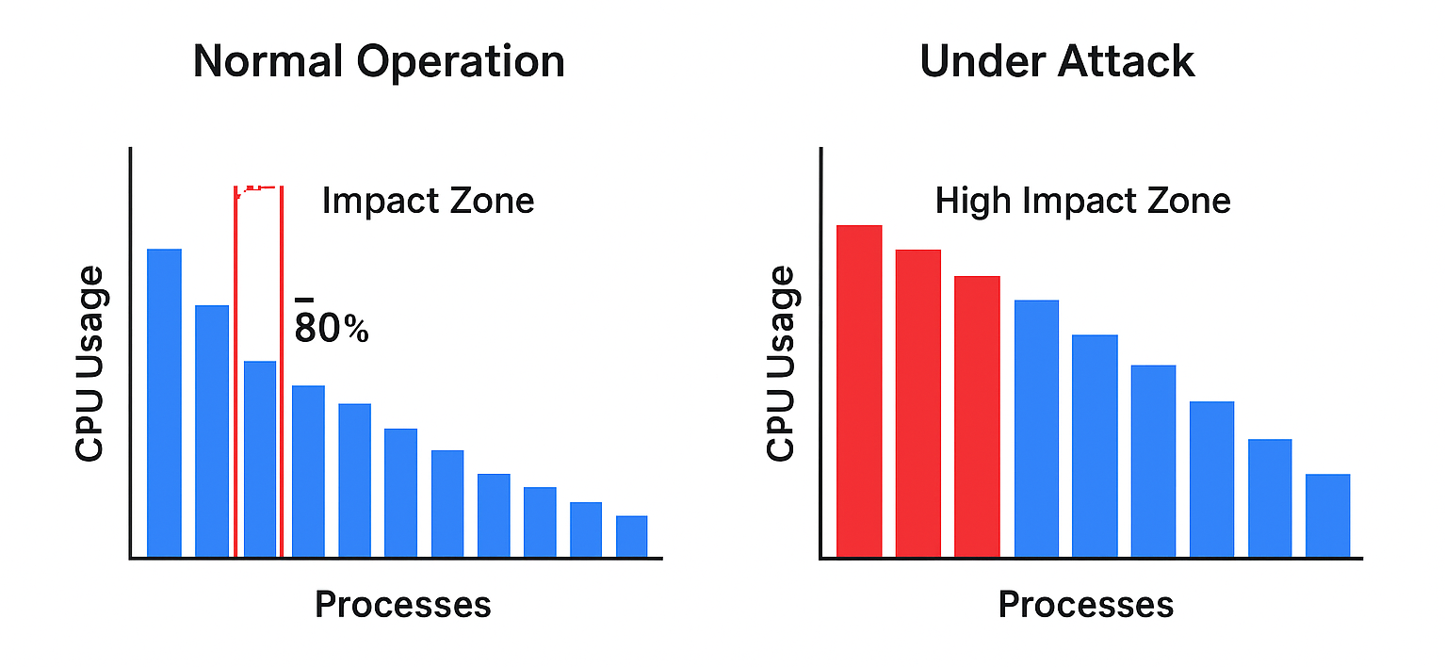
Why Pareto's Law Important in Computing?
Helps identify critical processes using most system resources
Enables faster problem detection and performance optimization
Reveals anomalous or malicious activity (e.g., crypto mining, malware)
Improves decision-making in cybersecurity and system management

Slide 7
Background & Motivation
Modern Machine Learning (ML) security models are often too complex, and expensive.
This leads to "Alert Fatigue," where security analysts are overwhelmed with false alarms and miss real threats.
We need a simpler, explainable, and cost-effective method to find abnormal resource usage.

Slide 8
Methodology Overview: Approach and Research Focus
Design-science with quantitative evaluation, Pareto Law tested on Windows 10/11/Server 2019 VMs
Workloads: Single/multi-apps, single/multi/domain users; Metrics: CPU, memory, disk I/O, network; Windows: 5/10/15 min
RQ: Do top 20% processes/flows contribute >80% usage? How do profiles/workloads shift compliance? Do protocols/endpoints show 80/20?
Hypotheses: H1 - Baselines compliant; H2 - Multi-conditions reduce compliance; H3 - Network shows 80/20

Slide 9
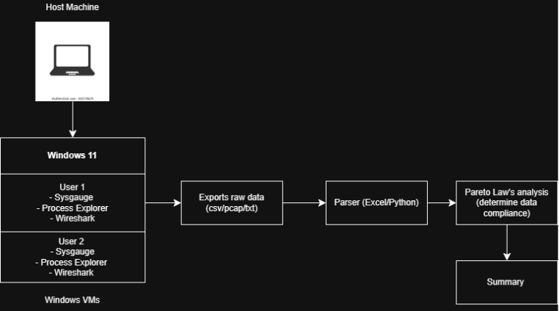
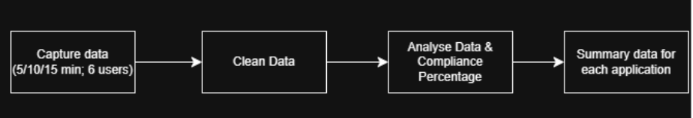
Topology & Pipeline

Slide 10


Methodology: Setup & Experiment
Lab Setup
The Experiment
Environment:
Phase 1: Baseline (Normal)
Windows 10, 11, & Server 2019 (Virtual Machines)
Ran common apps: Brave, Telegram, Visual Studio.
Tools:
Phase 2: Attack (Anomaly)
SysGauge: To monitor CPU & Memory
ProcessExp64: To monitor Disk I/O
Ran malicious exploits: Crypto-miner & PHP Backdoor.
Wireshark: To monitor Network Traffic(IPv4)
Python Script: To cleanse and conversion of data.

Slide 11
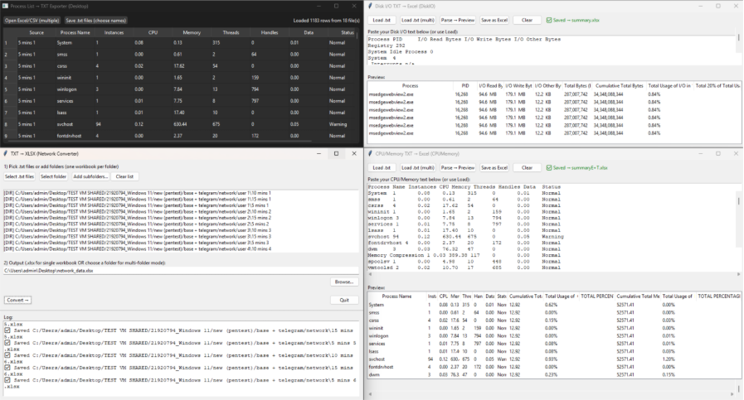
Python Script GUI application

Slide 12
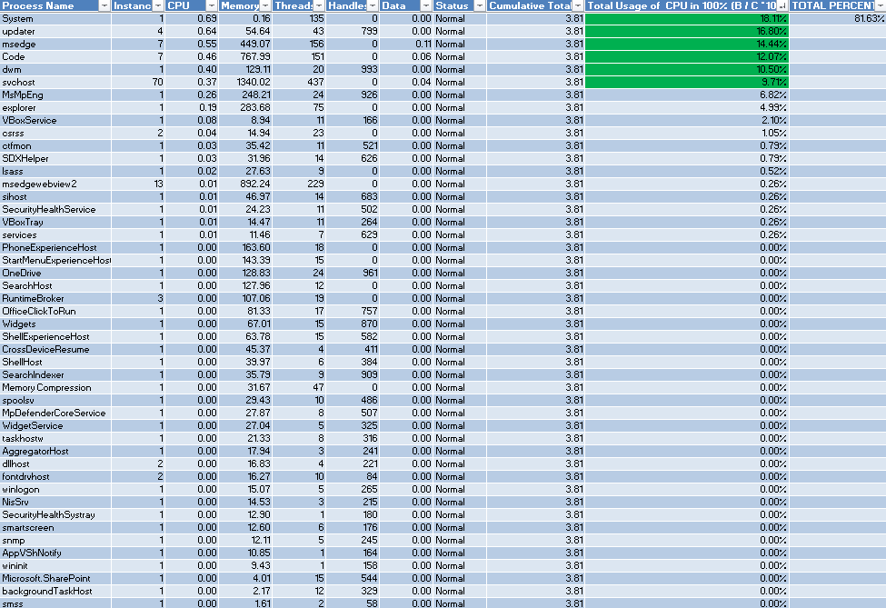
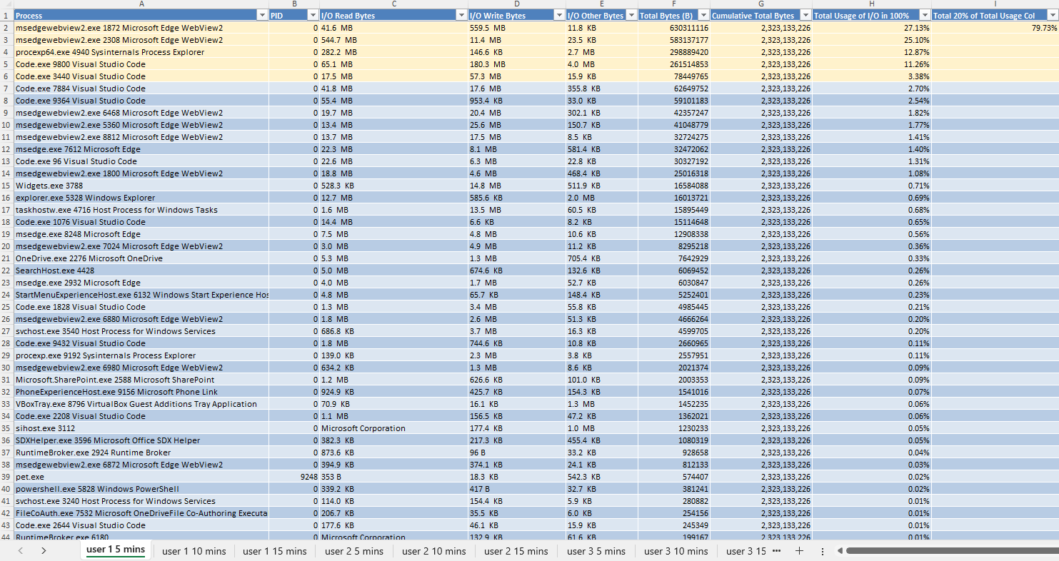
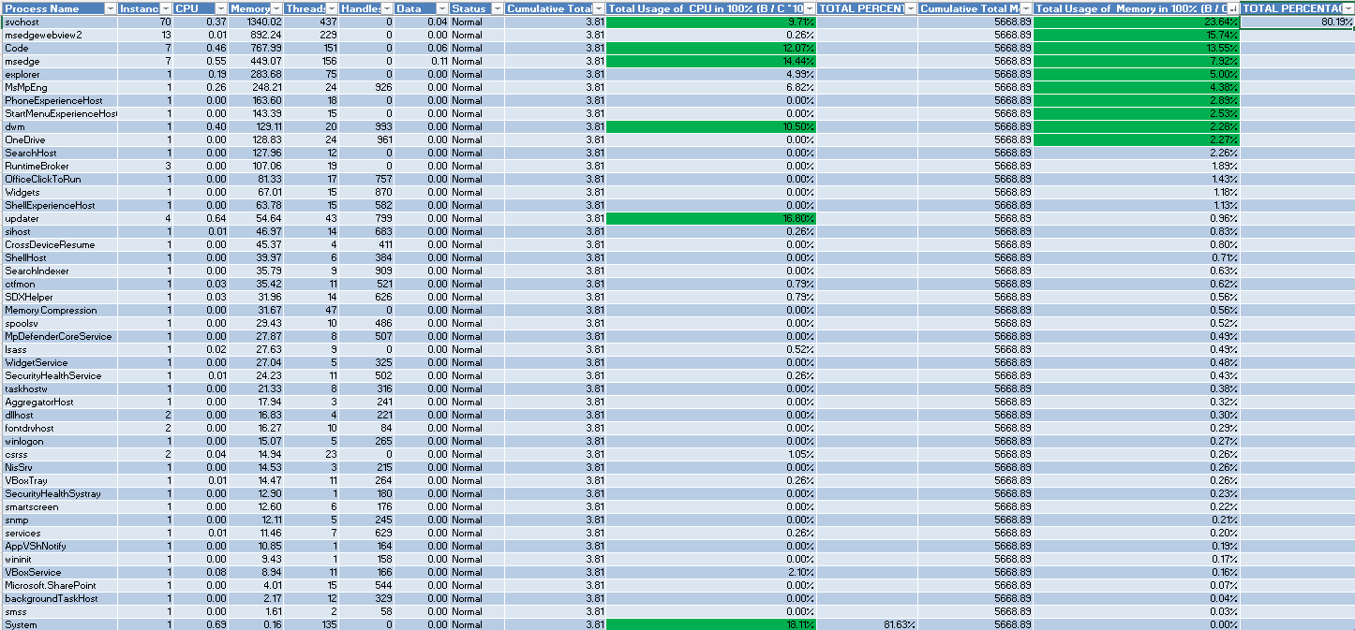
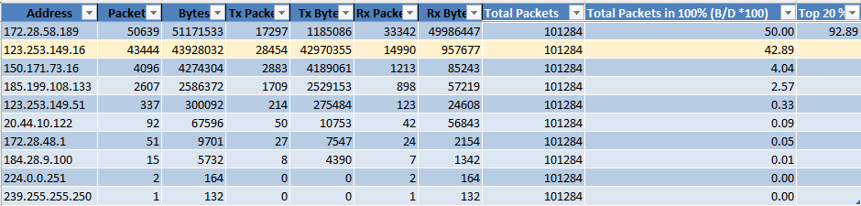
Sample of data cleanse and conversion Pareto compliance table

Slide 13
Results: Windows 10 and Windows Server (Baseline)
Windows 10 & 11
Windows Server
System (CPU) Baseline:
Under normal use, the CPU was mostly compliant.
Showed high compliance (>90%) at higher loads.
However, it was Non-Compliant (77%) at low load (1 User, 5 min).
System (Memory) Baseline
The Memory baseline was consistently Non-Compliant.
Usage remained spread out (62-68%) across all users and times.
This is a key finding: "normal" for this server is *not* 80/20 compliant for RAM.
Under normal use ("Telegram Only"), the 80/20 Law held true.
CPU Usage: Remained "Pareto Compliant" for all users, with the top 20% of processes using >80% of resources.
Memory Usage: Also compliant for most users.
This data represents a stable, balanced, and non-compromised system. This is our "normal."

Slide 14
Results: Windows 10 (Attack)
When the exploit was active, the Pareto balance broke, signaling an anomaly.
CPU Usage: Became "Non-Compliant" for one user (78.1%) as the exploit's processes competed for resources.
Memory Usage: Became "Non-Compliant" for ALL users, dropping to 70-77%.
This clear deviation from the "normal" baseline is a simple and effective alert.

Slide 15
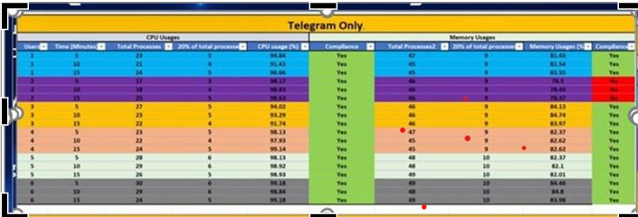
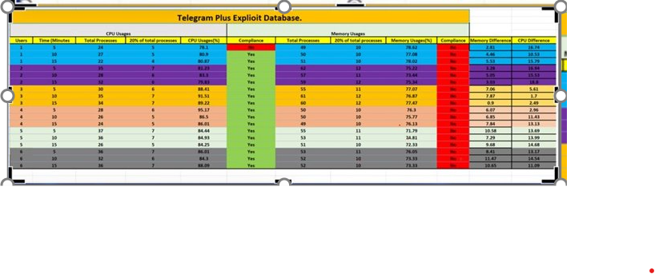
Windows10 Analysis:
Findings:
Under normal use, the Pareto Law (80/20) held true — around 20% of processes consumed approximately 80% of the CPU and about 80% of total-memory. Therefore, under normal operating conditions, the system remained Pareto-balanced (Yes).
During exploit simulations or crypto-mining activity, both CPU and memory usage spiked sharply, with only a few processes or network flows dominating resource consumption.
The Pareto balance broke, clearly indicating abnormal system behaviour without relying on signatures or machine learning methods.
Conclusion:
Pareto analysis alone effectively detected anomalies in both CPU and memory usage.
It is lightweight, explainable, and easy to interpret, making it ideal for SOC analysts to identify early warning signs of abnormal system activity.

Slide 16
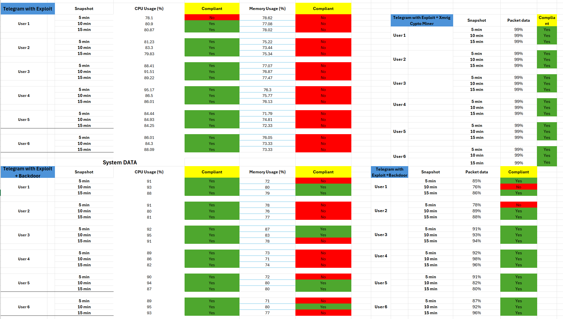
Summary of Result (Windows 10)

Slide 17


Results: Windows 11
System Anomaly (CPU/Memory)
Network Anomaly (Packets)
The system-level anomaly was immediate and obvious.
Network anomaly was immediate and obvious.
IPv4: Concentration is scenario-dependent—XAMPP + exploit setups reach 98–100%, while single-app workloads are generally above 80% with occasional dips.
CPU Usage: EasyMiner consistently dominates CPU usage across all users and time windows (≥90%)
Memory Usage: Memory usage remains consistently around 80–82% across all scenarios
Resource Impact: Exploits significantly increase IPv4 and CPU concentration, especially when combined with EasyMiner, while memory usage remains stable around 80–82% across all scenarios.
Finding: CPU usage patterns effectively differentiate between normal and anomalous behavior, whereas memory usage shows limited variability, making it less reliable for anomaly detection.

Slide 18
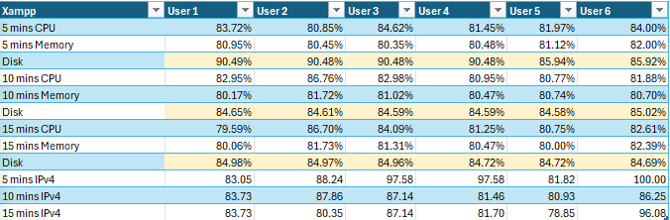
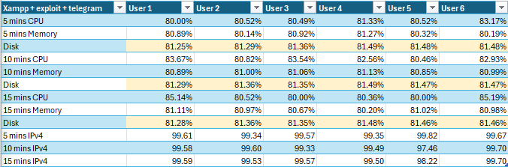
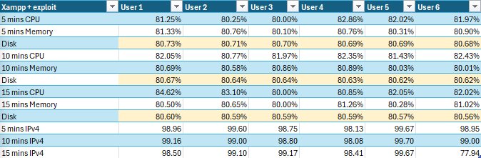
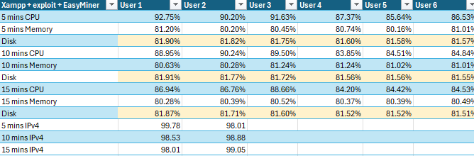
Summary of Result (Windows 11)

Slide 19
Results: Windows Server 2019
System Anomaly (CPU/Memory)
Network Anomaly (Packets)
The system-level anomaly was immediate and obvious.
The network anomaly was delayed and scaled with load.
CPU Usage (1 User, 5 min): Jumped from 77% (Baseline) to 97% (Attack).
1 User: No change.
2 Users (10 min): Showed a +11% deviation.
Memory Usage (1 User, 5 min): Increased from 62% to 67%.
3 Users (15 min): Showed a +14% deviation.
Finding: The anomaly was only visible on the network with more users and time.
Finding: The exploit created an instant, high-resource process.

Slide 20
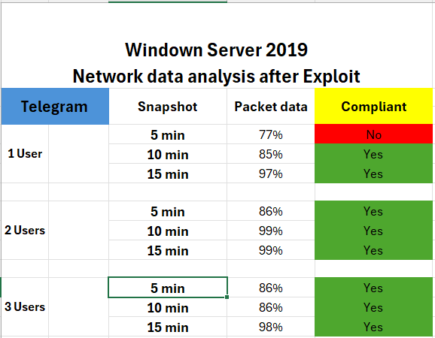
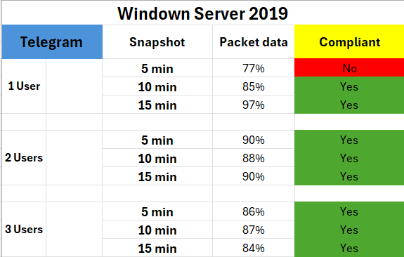
Results: Windows Server 2019 Network

Slide 21
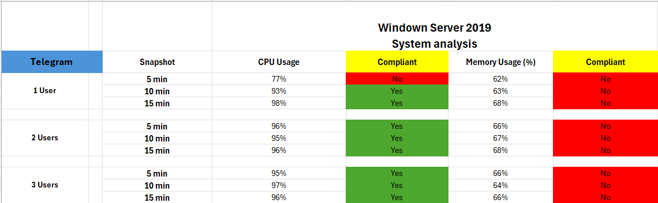
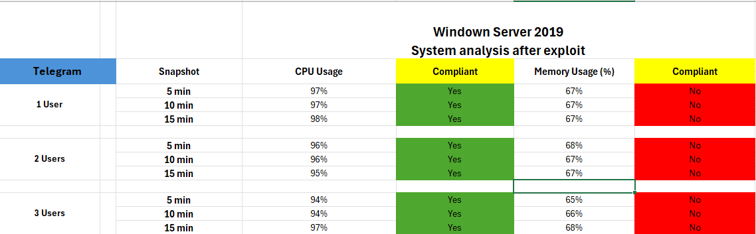
Results: Windows Server 2019 System Process

Slide 22
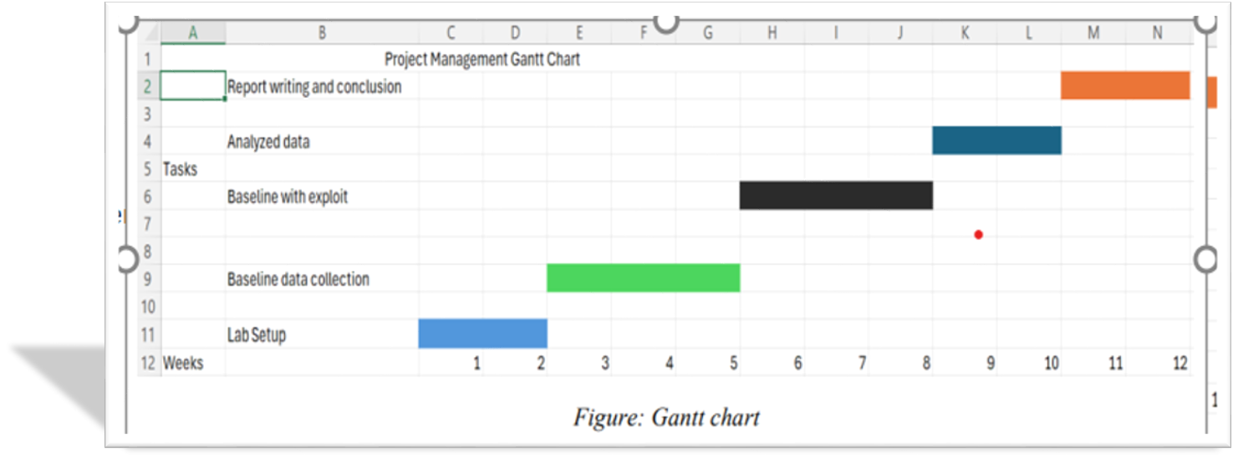
Project Management
Team Roles
MingYong: Windows 11
Anuj: Windows Server 2019
Abdul: Windows 10 (Crypto, Backdoor)
Diwash: Windows 10 (Network)
Samrat: Windows 10 (System) Project Management & Editing
Key Challenge
VM slowdowns and network "noise" required careful filtering and resource management.

Slide 23
The Future of Project
Integrate Pareto analysis with AI for automated anomaly detection
Apply Pareto’s Law to large-scale cloud and IoT systems
️ Enhance cybersecurity monitoring by prioritizing high-impact threats
Real-time visualization of 80/20 trends for decision-making
🧠
☁️
🛡️
📊

Slide 24
Conclusion: It Works (Some Stages)
Pareto's Law is a simple, reliable, and effective way to detect significant system anomalies.
The deviation from the baseline is the alert, and it's easy to measure.
This method is:
Simpler & cheaper than ML.
Transparent (not a "black box").
A practical way to reduce "Alert Fatigue".

Slide 25
Thank You
Questions?

